Slide 1




Agile Development Practices
A course from
ThoughtWorks Studios

Slide 2
Agenda
Introductions
Pair Programming
Test-Driven Development
Refactoring
Mocking
BDD and functional testing
Continuous Integration
Continuous Delivery
Retrospective

Slide 3
Who Are We?
Luca, Kelley and Vlad

Slide 4
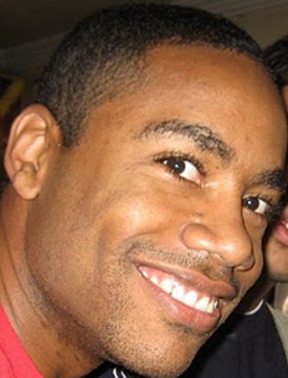
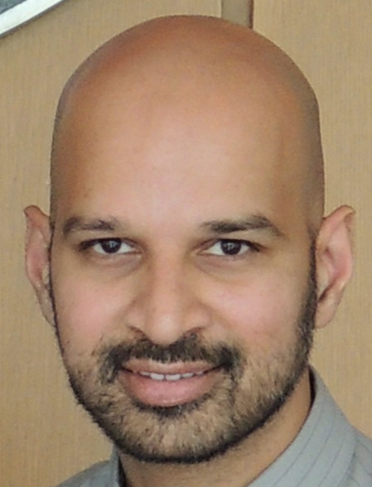
Who Are We?
Damon Maneice
Developer and Trainer
dmaneice@thoughtworks.com
Saleem Siddiqui
Developer and Agile Coach
saleem@thoughtworks.com

Slide 5
Who are you?
Who are you?
What do you do?
Why are you here?
All in 30 seconds or less

Slide 6
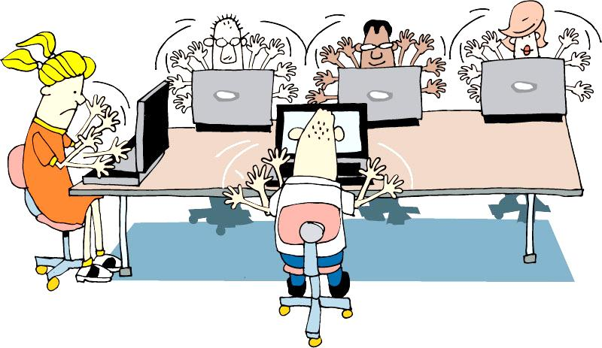
Housekeeping
Take phone calls outside team room
Laptops down unless doing team work
Questions as we go or in parking lot
Break when needed
Be on time
Work in pairs
Notes:
We will try our best to answer any questions as the sessions progress.
Any questions which can’t be answered during the course of a session will go in the parking lot , we will take those at opportune moments.
Participate fully in all exercises. Try to complete all tasks to the best of your ability.
Ask for assistance. No one’s perfect, and it’s expected that you’ll ask for all necessary explanations.
No sleeping.
One discussion at a time.
We have scheduled break times, but you can agree with your pair to take other breaks as needed

Slide 7
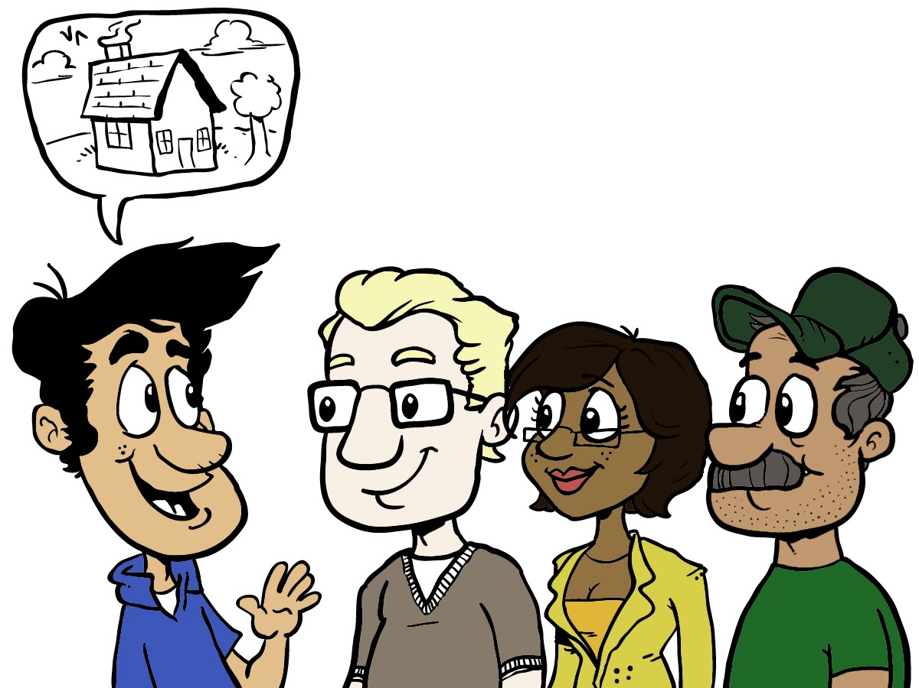
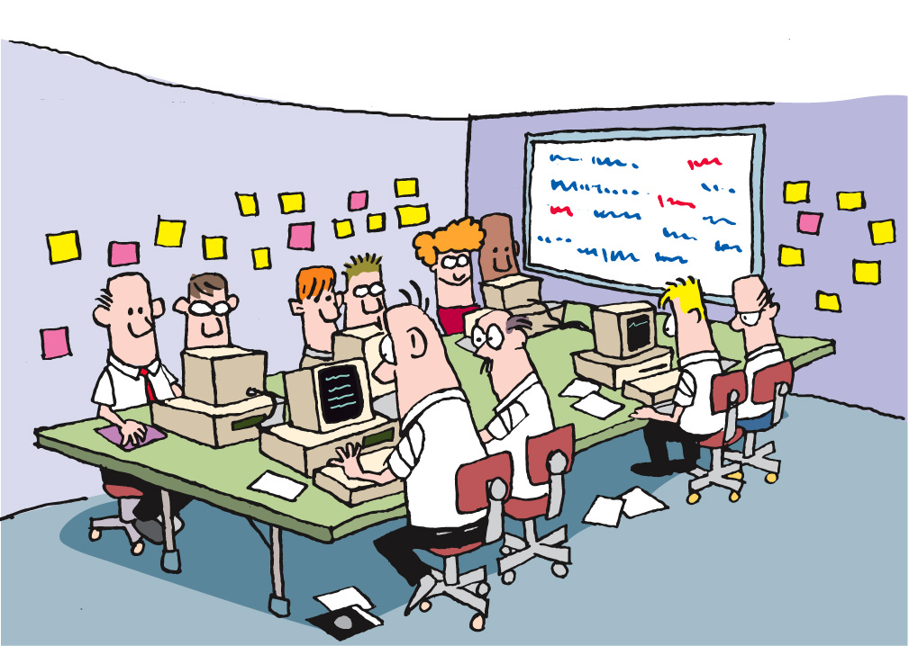
Housekeeping
for(int i=0; i<10; i++) {
System.out.println(“Hello World!”);
}
Presenting
Coding
Notes:
Emphasize that there will be two main modes of learning used during the workshop: Presenting and Learning

Slide 8
Presenting
for(int i=0; i<10; i++) {
System.out.println(“Hello World!”);
}
One conversation
Attention to the speaker
Laptops closed or put aside
Notes:
Presenting is when someone (could be facilitator but often it’ll be one of the participants) is showing code or other artifacts on the display. During this mode, we’ll need everyone’s attention (laptops down or put aside). Questions and lively conversation is welcome; as long as rules of discourse are obeyed (one conversation at a time)

Slide 9
Coding
Several conversations
Use your inside voice!
Laptops open (of course)
Notes:
Coding is when the attendees will work on the code samples in pairs. This is “heads down” activity, with every pair focused on their workstation/laptop. There will be lots of “low-decibel” conversations (one per pair) in the room. The facilitators will help the attendees. The attendees will help each other as well. There will be a gentle “hum” of these several conversations in the room during the Coding mode.

Slide 10
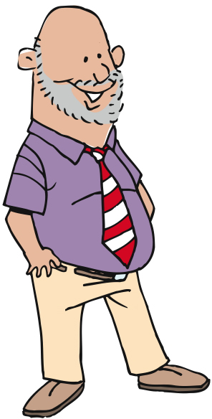
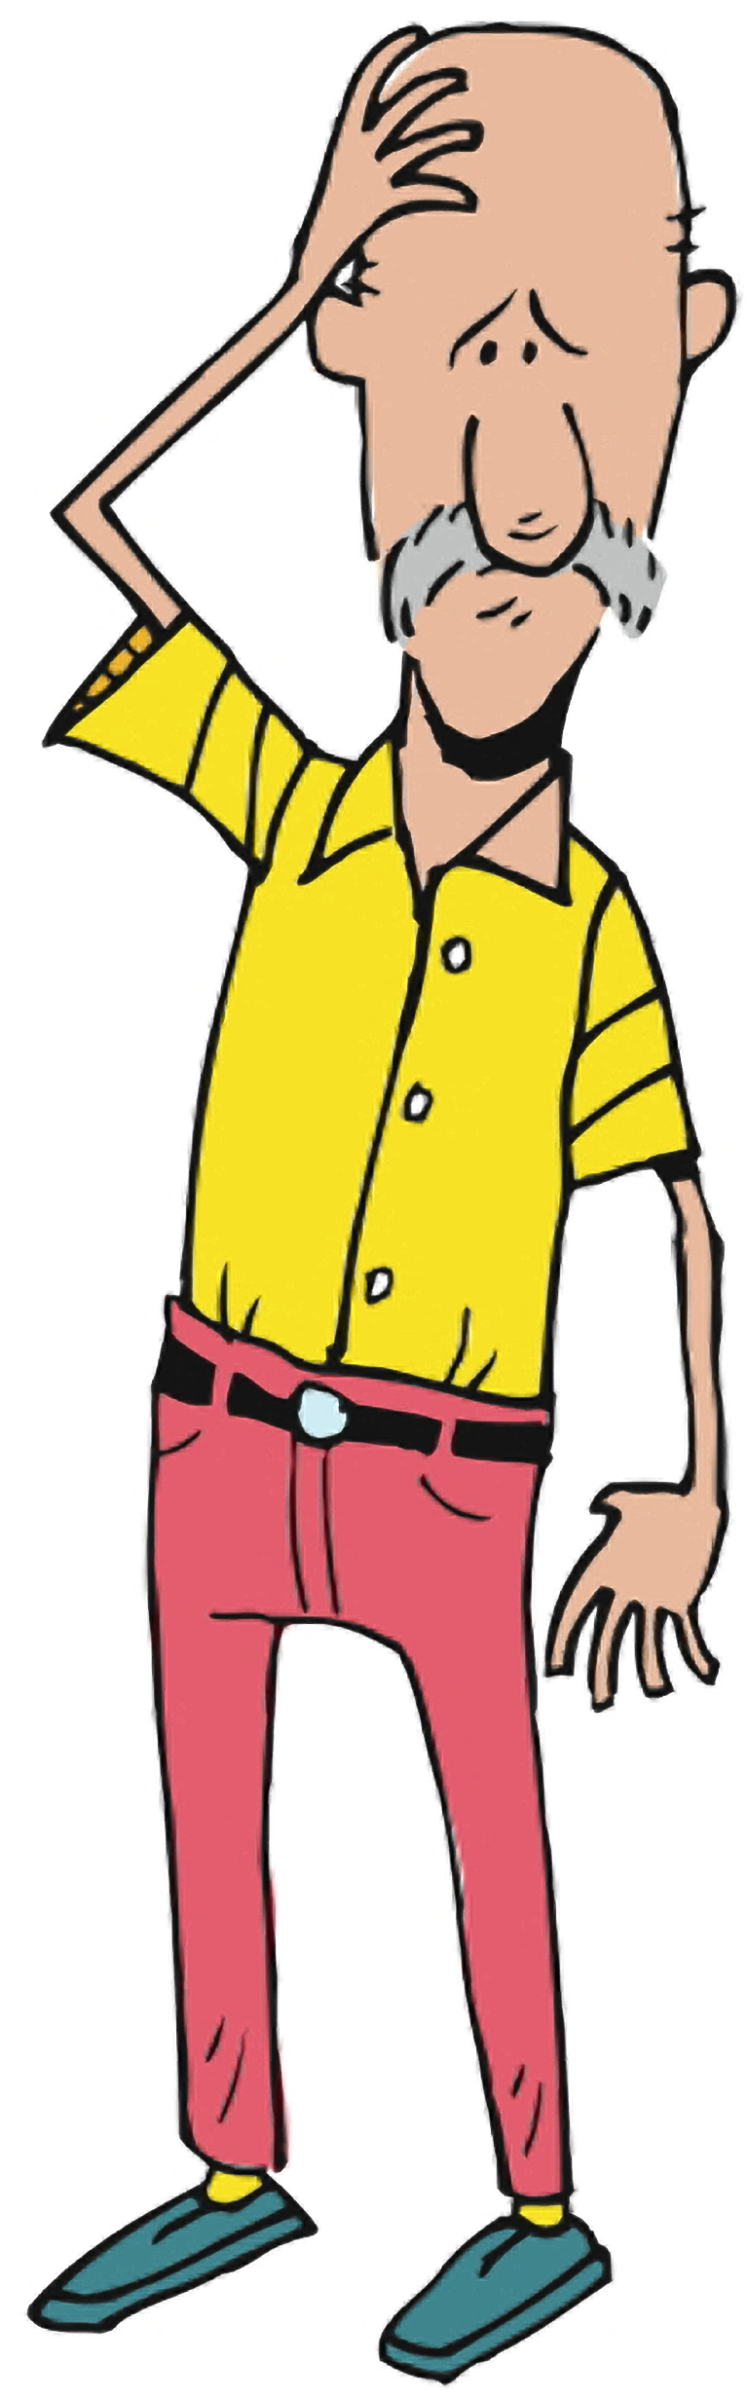
Why Are We Here?
Hopes
Concerns

Slide 11
Empathy mapping

Slide 12
Learning Objectives
Understand the role of a Developer in an Agile team
Learn how the different Development practices work together
Have some fun!

Slide 13
Agile Recommended Practices
Automated
Build/Deploy
Iteration kickoff/ planning meeting
Short
Releases
Pair
Programming
Retrospectives
Refactoring
Automated
Testing
Daily
Stand-ups
Collective
Ownership
Card Wall
Simple Design
Velocity
Metrics
Test Driven
Development
Coding
Standards
Iterations
Co-location
INDIVIDUAL
User
Stories
Sustainable
Pace
Continuous
Integration
TEAM
On-site
Customer
ORGANIZATIONAL

Slide 14
Our Subset
Automated
Build/Deploy
Short
Releases
Pair
Programming
IKO/IPM
Retrospectives
Refactoring
Automated
Testing
Daily
Stand-ups
Collective
Ownership
Card Wall
Simple Design
Velocity
Metrics
Test Driven
Development
Coding
Standards
Iterations
Co-location
INDIVIDUAL
User
Stories
Sustainable
Pace
Continuous
Integration
TEAM
On-site
Customer
ORGANIZATIONAL

Slide 15
“Open the Box”
Split into teams of two
Log into Skytap
Run unit tests
Run a functional test
Any observations?
Notes:
These are the old instructions, when we used Skytap for each dev environment.

Slide 16
“Open the Box”
Split into teams of two
Get source code (N = 1, 2, 3…)
mkdir /agiledevpractices/videoworld
cd /agiledevpractices/videoworld
svn co svn://<ip_address>/trunk/pairN videoworld
Run unit tests
Any observations?
Notes:
As of April 2013, the url for the Skytap environment is: svn://199.204.218.74/trunk/pairN where N=1..9

Slide 17
Questions?

Slide 18
Pairing

Slide 19
Why to Pair?
Notes:
More defects avoided or detected early
Knowledge sharing, for training or for being able to go in holiday
Increased code quality, better design that communicate the intention more
Better problem solving
More focus and less disctractions

Slide 20
How to Pair
Start with a reasonably well-defined task before you sit down
Agree on one tiny goal at a time
Rely on your partner, support your partner
Talk a lot!
Sync up frequently
Take a moment to celebrate as you complete tasks and overcome problems
Switch roles often—at least every 15 minutes
http://www.wikihow.com/Pair-Program

Slide 21
Pairing Infrastructure

Slide 22
Monitors
One Monitor
Both Pairs are looking at the same location
Smaller Desktop
Two Monitors – Mirrored
Pairs not looking at the same location
Smaller Desktop
Conversations don’t come as easily
Two Monitors – Spanned
Both Pairs are looking at the same location
One Huge Desktop
Enables more non-verbal communication

Slide 23
Keyboard and Mouse
One Shared
Encourages Communication
Must either express yourself or ask for the keyboard
Two (One for each person)
Faster to take control
Less physical movement
Less germ spreading!

Slide 24
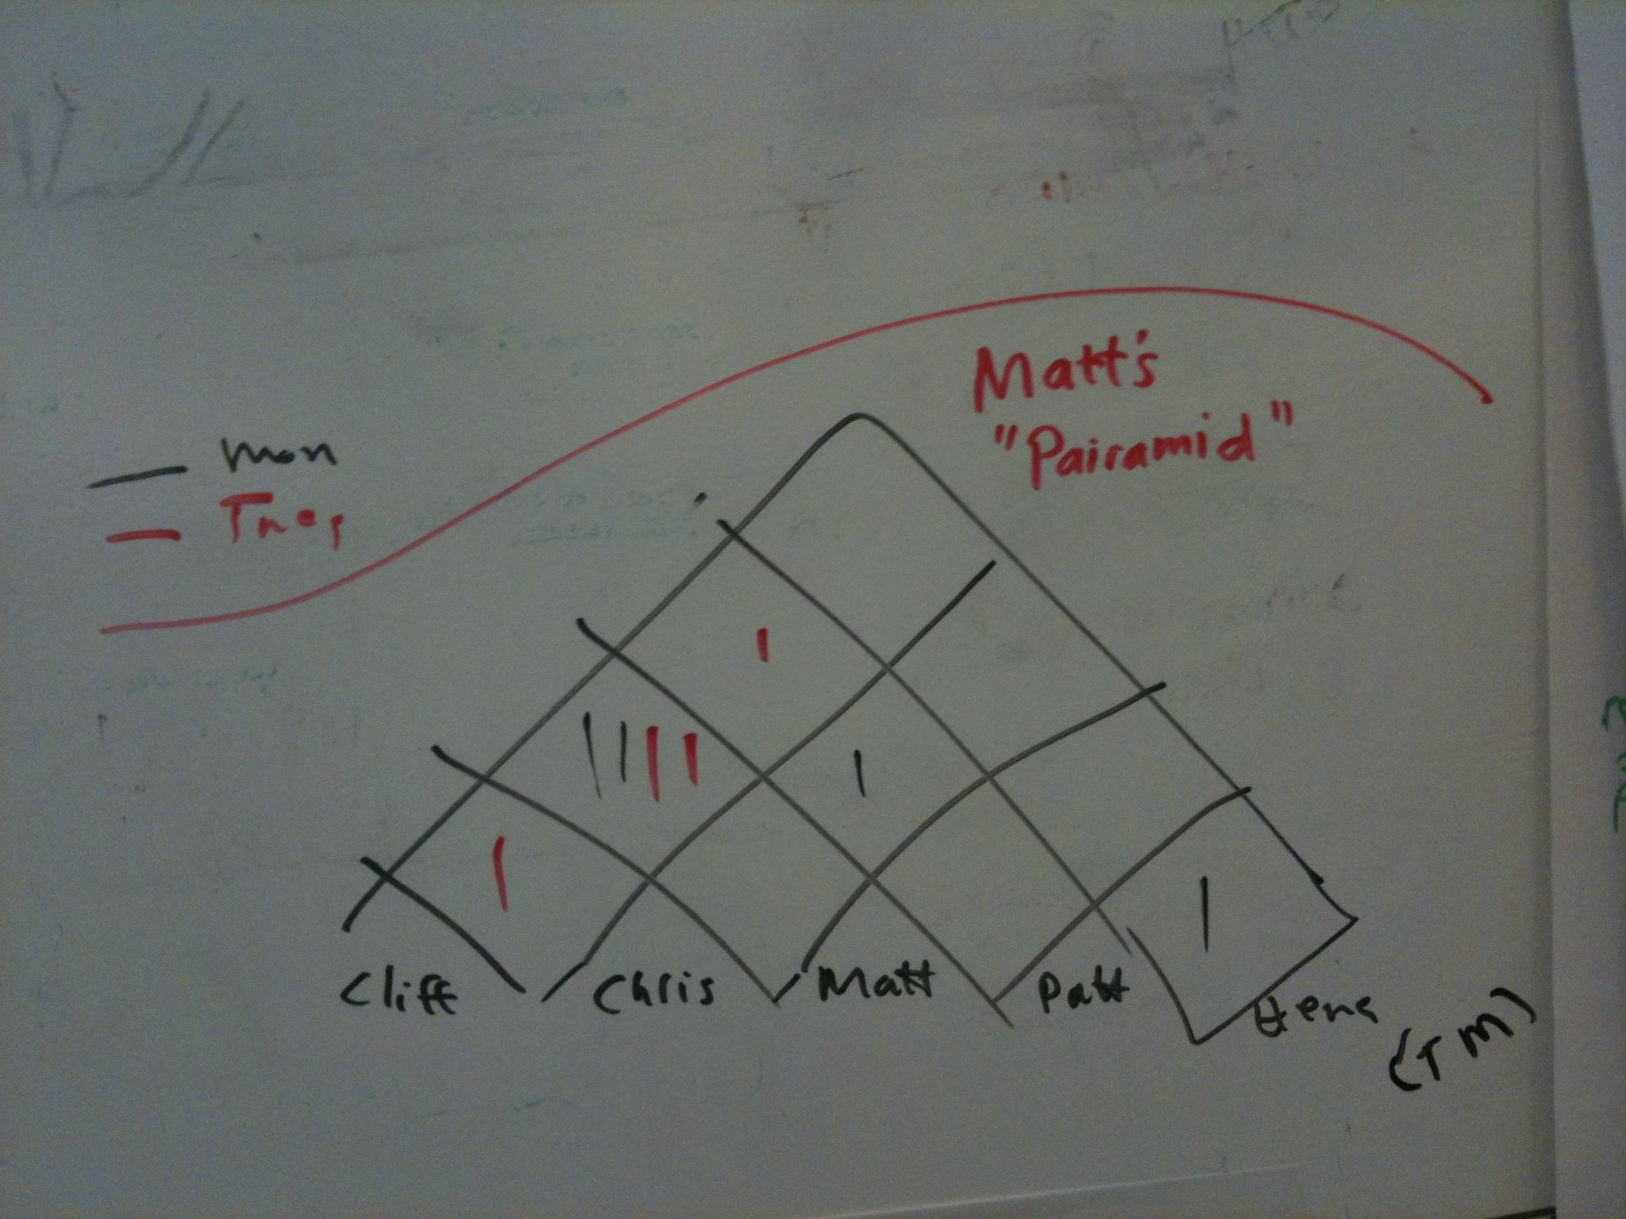
Pair Rotation Techniques
Egg Timer / Chess Clock
Encourages rotation of roles within a pair
Driver swapping
Pair Stair/Pairamid
Encourages working with everybody
H
G |  |  |  |  |  |  |  | 1
F |  |  |  |  |  |  | 2 | 3
E |  |  |  |  |  | 1 | 3
D |  |  |  |  | 2
C |  |  |  | 1
B |  |  | 2 | 3
A |  | 1 | 3 |  |  |  |  | 2
 | A | B | C | D | E | F | G | H

Slide 25
Pairing Styles

Slide 26
Pairing Styles
Driver & Navigator
Driver works tactically, Navigator works strategically
Easiest to start with
Roles should be swapped as frequently as possible

Slide 27
Pairing Styles
Ping-Pong
'A' writes a test, 'B' makes it green.
Next 'B' writes the test, 'A' makes it green
A mix of Pairing and Test Driven Development (TDD)

Slide 28
Pairing Styles
Ball & Board
Advanced pairing technique
One person controls the mouse (The Ball)
The other person controls the keyboard (The Board)
Useful for forcing yourself to learn keyboard shortcuts
You either learn them, or have to ask the Ball to do things for you

Slide 29
Pairing Demo
Notes:
This is a short 1-minute video that is useful to explain the role of the Driver in keeping the focus on the big picture:
Test Your Awareness: Do The Test http://youtu.be/e5zGeHAv9VA
Interesting and funny video, 50mins long, about pair programming:
- Niclas Nilsson & Hans Brattberg - The Pair Programming Show http://vimeo.com/7814261
Here follow a selection of the main scenes to to cut the watching time down to 20 minutes:
- from 5:40 to 12:05 flow scene and no collaboration scene
- from 16:25 to 19:30 back sit driver scene
- from 34:30 to 40:13 under pressure scene
- at 46:02 the summary slide

Slide 30
Story #9
As a customer
I want to see my frequent renter points for this order in the Transaction History
So I know when I'm eligible for a free rental
Notes:
Acceptance criteria
One point per rental
Display on statement history

Slide 31
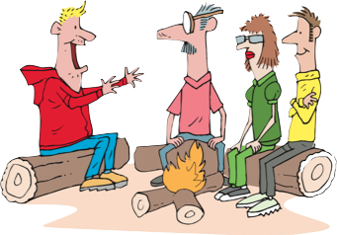
Story 4
Role: As a customer
Goal: I want to view my accumulated frequent renter points
Value: So that so that I know when I get the free movie

Slide 32
Test Driven Development

Slide 33
Test Driven Development
Why TDD?
All your code is testable by definition
Encourages better design by enforcing loose coupling
Tests as documentation
Clear examples of how to use APIs
Provably correct documentation
Confidence to allow refactoring
Can change the underlying design without changing behavior

Slide 34
The 3 dimensions of TDD
Specification
Design
Verification
Notes:
TDD Continuum:
For Specification, see i.e. BDD
For Verification, see i.e. the triangulation from Kent Back
For Design see next slide
The triangle in action: http://scratch.mit.edu/projects/13134082/

Slide 35
The Synergy between TDD and Design
Michael Feathers:
Writing tests is another way to look the code
and locally understand it and reuse it.
And that is the same goal of good OO design.
Notes:
Michael Feathers, NDC 2010
The Deep Synergy Between Testability and Good Design
http://vimeo.com/15007792
http://michaelfeathers.typepad.com/michael_feathers_blog/2007/09/the-deep-synerg.html

Slide 36
Test Driven Development
Uncle Bob Martin’s Three Laws of TDD
You are not allowed to write any production code unless it is to make a failing unit test pass
You are not allowed to write any more of a unit test than is sufficient to fail; and compilation failures are failures
You are not allowed to write any more production code than is sufficient to pass the one failing unit test

Slide 37
TDD Cycle
Red
The development of every new feature should start with a failing test
Green
Enough production code should be written to make the test pass.
Refactor
Improve the structure of the code to ease future changes and maintenance.

Slide 38
Basic structure of unit tests
Set up
Execute
Verify

Slide 39
Organizing tests
One test class per class
One test case per scenario

Slide 40
Other key points
Test names should express intent
Keep test logic out of production code (e.g., no if(testing)… else … )
Ideally have only one assertion per test

Slide 41
Feathers’s rule of thumb, extended
A test is not a unit test if:
It talks to the database
It communicates across the network
It touches the file system or read config info
It uses DateTime.now() or Random
It can't run at the same time as any of your other unit tests
You have to do special things to your environment (such as editing config files) to run it.

Slide 42
Story #1
As the marketing coordinator
I want to introduce a new pricing model for new releases giving 1 free day for week rental
So that I can encourage longer rentals

Slide 43
Story #11
As a content provider
I want to have a promotion where every regular 3 day rental gets an extra day
So that I can encourage longer rentals

Slide 44
Refactoring

Slide 45
Refactoring
What it is
The art of improving software readability and design of existing code without changing behavior
A series of small steps
Refactoring changes the balance point between up-front design and emergent design.
What it is not
rewriting from scratch

Slide 46
Some history
William Opdyke - 1992
Refactoring Object-Oriented Frameworks[1], was the first in-depth study of code refactoring as a software engineering technique
Problem:- It is hard to change ‘existing’ OO programs.
Solution:- Can we automate ‘code restructiring’?
Martin Fowler
The famous ‘Refactoring’ book.
www.refactoring.com

Slide 47
Smells
Warning signs about potential problems in code.
Sample smells
Unclear names of class, methods, variables, parameters
Comments
Long Method and large Class
Nested conditionals and loops
Code and Logic duplication

Slide 48
Refactoring Cycle
Start with a working program.
While smells remain:
Choose the worst smell.
Select a refactoring that will address the smell.
Apply the refactoring.

Slide 49
Refactoring Examples

Slide 50
Refactoring Examples
Rename
Sometimes you come across a method or variable that doesn’t describe:
The only way to understand it is to read more code
Rename to describe what it returns:
String n = participant.n()
String name = participant.name()
Notes:
JAVA CODE

Slide 51
Refactoring Examples
Commented code:
Symptoms
Comment symbols (// or /*) appear in the code.
Some comments are helpful:
Those that tell why something is done a particular way (or why it wasn't)

Slide 52
Refactoring Examples
Extract Method
When a method does many things it can be difficult to read
Comments and whitespace often exposes grouping
public void printReceipt() {
// Header
print(“Receipt Header”)
// Content
print(“…content…”)
}
Notes:
JAVA CODE

Slide 53
Refactoring Examples
Extract Method
When a method does many things it can be difficult to read
public void printReceipt() {
printHeader()
printContent()
}
private void printHeader() {
print(“Receipt Header”)
}
private void printContent() {
print(“…content…”)
}

Slide 54
Split Loop
Split Loop
Used to simplify logic that occurs in a loop
public void saveTotals(items) {
for(item in items) {
totalPoints += item.points
totalCost += item.price
}
}

Slide 55
Refactoring Examples
Split Loop
Used to simplify logic that occurs in a loop
Now you can extract method to describe what they do
public void saveTotals(items) {
for(item in items) {
totalPoints += item.points
}
for(item in items) {
totalCost += item.price
}
}

Slide 56
Refactoring Examples
Split Loop
public void saveTotals(items) {
addPoints(items)
addPrice(items)
}
private void addPoints(items) {
for(item in items)
totalPoints += item.points
}
private void addPrice(items) {
for(item in items)
totalCost += item.price
}

Slide 57
Refactoring Examples
Long Method
public static void report(Writer out, List machines, Robot robot) throws IOException
{
out.write("FACTORY REPORT\n");
Iterator line = machines.iterator();
while (line.hasNext()) {
Machine machine = (Machine) line.next();
out.write("Machine " + machine.name());
if (machine.bin() != null)
out.write(" bin=" + machine.bin());
out.write("\n");
}
out.write("\n");
out.write("Robot");
if (robot.location() != null)
out.write(" location=" + robot.location().name());
if (robot.bin() != null)
out.write(" bin=" + robot.bin());
out.write(”\n========\n");
}
}
Notes:
C# CODE
Method more than 5 – 10 lines is bad.

Slide 58
Refactoring Examples
Long Method
public static void report(Writer out, List machines, Robot robot) throws IOException {
printTitle(out);
printMachineDetails(out, machines);
printRobot (robot);
}
private static void printTitle() {
out.write("FACTORY REPORT\n");
}
private static void printMachines(List machines) {
Iterator line = machines.iterator();
while (line.hasNext()) {
Machine machine = (Machine)line.next();
out.write("Machine " + machine.name());
if (machine.bin() != null)
out.write(" bin=" + machine.bin());
out.write("\n");
}
out.write("\n");
}
private static void printRobot (Robot robot) {
out.write("Robot");
if (robot.location() != null)
out.write(" location=" + robot.location().name());
if (robot.bin() != null)
out.write(" bin=" + robot.bin());
out.write(”\n========\n");
}
}
Notes:
Create smaller methods with good names

Slide 59
Refactoring Exercise
Refactor the comments in Customer.statement
Identify and refactor the violations of the LoD in Customer.statement

Slide 60
Story #7
As a customer
I want to see previous receipts
So that I can balance my checkbook

Slide 61
Redesign

Slide 62
Refactoring vs. Redesign
Refactoring
Refactoring happens as normal part of development
No ‘permission’ needed by the team to refactor
Redesign
Large scale refactoring/redesign decisions should be owned by the whole team
Potentially takes many days
Often assigned its own story card
Allows for estimation & prioritization
Notes:
Point out the importance of keeping refactoring and redesign separate
Large redesigns are NOT refactoring
Be clear with the business owners that any redesigns are an investment in future speed and maintainability.

Slide 63
Redesign
Tips
Check in before beginning
Allows easy back out
If unsure of design, spike a solution
Don’t worry about testing, just go as far as you can to learn what will work
ALWAYS back out your spike and start again with tests
Work in VERY small steps
Keep the tests passing throughout the entire redesign

Slide 64
Redesigning Legacy Code
Strangler Pattern
Useful when test coverage is not sufficient
Involves wrapping the bad portion of the code with a new design that delegates.
Any new functionality goes into the new design
Over time, the old code will be used for less and less functionality
Useful Resources
http://martinfowler.com/bliki/StranglerApplication.html
“Working Effectively with Legacy Code” by Michael Feathers

Slide 65
Story #10
As a customer
I want to see how much total I’ve spent
So I can manage my budget

Slide 66
Mocking
Unit testing with test double

Slide 67
Definition: Test Double
In automated unit testing replaces an object on which the class under test depends Can be a Stub, a Mock a Spy

Slide 68
Definition: Stub
Has configurable canned responses
Is used to control the indirect input to the class under test

Slide 69
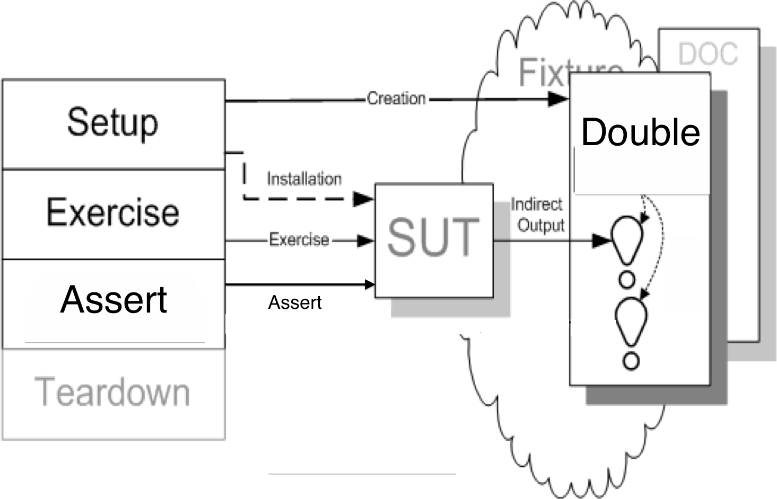
Stubbing

Slide 70
Mocking Exercise
Test the total ViewCurrentRentalsAction Stubbing the rentalRepository

Slide 71
Definition: Strict Mock
Has configurable expectations
Used for verifying messages sent by the class under test
Test fails when expected msg is not sent Test fails when unexpected msg is sent

Slide 72
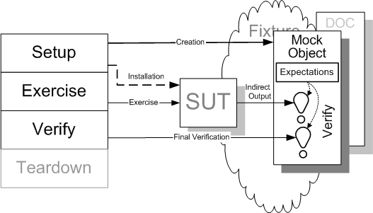
Mocking

Slide 73
When do you use Stubs?
To fake the external dependencies of the object under test. As:
File System
Config info
Database
Network
E.g. Web services
Behavior you don’t have control on
E.g. DateTime.now() or Random

Slide 74
When do you use Mocks?
Receives
Sends/Does
Incoming messages
Outgoing messages
Object under Test
Methods calls
Calls to ext. depend.

Slide 75
When do you use Mocks?
Type of messages and method calls:
Query: return something, change nothing
Command: return nothing, change something

Slide 76
When do you use Mocks?
Mock method calls
done by the object under tests
to external dependencies’ methods that
return nothing (void)
and change nothing (visible state)

Slide 77
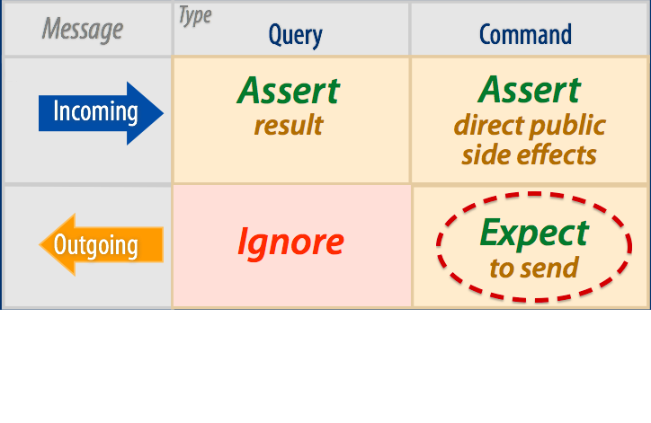
When do you use Mocks?
From Sandi Metz
Notes:
Magic Tricks of Testing , Sendi Metz, https://speakerdeck.com/skmetz/magic-tricks-of-testing-railsconf

Slide 78
How do you use it (Moq)?
Object interactions
Method called correctly.
Correct parameters are passed.
var mockPrice = new Mock<IPrice>();
mockPrice.Setup(foo => foo.CalculateRental(It.IsAny<string>())).Returns(10);

Slide 79
What do you test with Mocks?
Object interactions
Method called correctly.
Correct parameters are passed.
mockPrice.Verify(foo => foo.CalculateRental("Avatar"));

Slide 80
How do you use it (Mockito)?
Object interactions
Method called correctly.
Correct parameters are passed.
import static org.mockito.Mockito.*;
…
Price mock = mock(IPrice.class);
when(mockPrice.calculateRental(anyString()).thenReturn(10);

Slide 81
What do you test?
Object interactions
Method called correctly.
Correct parameters are passed.
verify(mockPrice).calculateRental("Avatar");

Slide 82
What do you test?
How your objects work for various responses from other objects

Slide 83
Suggestions
Mock/Stub instead of creating ‘new’ objects
Only mock those methods that SUT calls
Consider carefully where to use Mocks and where Stubs

Slide 84
Mocking Demo

Slide 85
Functional Testing

Slide 86
What is Functional Testing?
Definitions
Functional testing refers to tests that verify a specific action or function of the code. These are usually found in the code requirements documentation, although some development methodologies work from use cases or user stories. Functional tests tend to answer the question of "can the user do this" or "does this particular feature work".
Wikipedia
Business-facing, product-facing tests
Tests that prove you “built the right thing” (as opposed to “built the thing right”)
Notes:
AKA Story tests, customer tests

Slide 87
What is Functional Testing?
Types of Functional Tests
Acceptance tests, testing "from a user perspective”
Particularly relevant in Agile
Guarantees that the requirement is implemented in the software as specified
Regression tests that reflect a particular defect found in production
System Integration testing (i.e. does the application work all the way through)

Slide 88
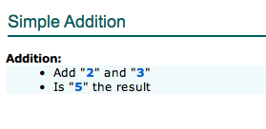
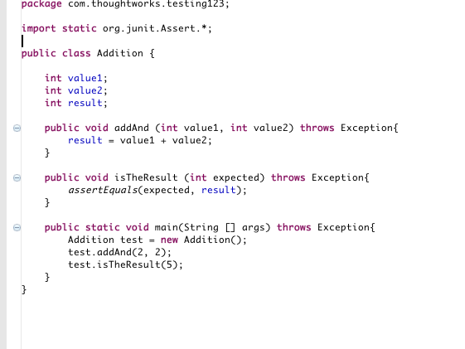
What is Functional Testing?
Example of automated functional test

Slide 89
Functional Testing
Automating Functional Tests
Functional Test Automation Makes Testing an Asset
Living documentation
Why Functional Test Automation?
Unit Testing is Fundamentally different
Automated Testing Has Additional "Gotchas"
Notes:
Answers important strategic questions:
How can tests be executed early and often enough to mitigate risk?
How can tests be maintained as long-lived, evolving, and reusable assets?
How can testing involve all the stakeholders in the software development process such that requirements are fully understood and tested?
How can the highest value most essential testing be identified?
Functional test automation is not an end unto itself – it’s a tool and a capability
Automation does a few things very well:
Makes regressions run faster, freeing testers up to think, not click
Allows for running tests in different environments and on different platforms
Shores up the safety net
Extends your capacity to cover different testing models
Gives fast feedback to teams
Reduces the defects that make it to production by providing frequent regression checks
Makes requirements clearer by giving developers executable acceptance tests
Automation does not:
Find all of the bugs a user might encounter
Find logical inconsistencies, performance, security or UX problems in the application
Cover all boundary conditions, particularly at higher levels
Many organizations believe that unit tests are a panacea for software quality
Unit tests are good at a few things:
Preserving developer intention
Helping developers design code better
Helping developers think through boundary conditions
Unit tests aren’t good at:
Checking integration between components
Validating that software works from a user perspective
Finding unanticipated errors
Covering all boundary conditions
Brittleness
Maintainability
Time Required
Not inherently collaborative

Slide 90
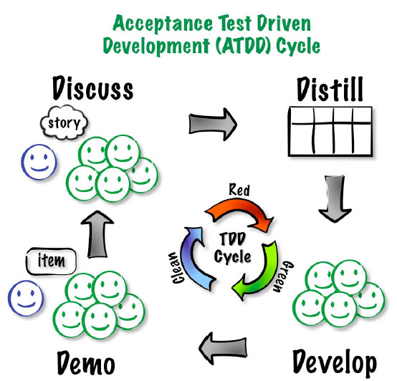
ATDD Functional Testing
Notes:
Answers important strategic questions:
How can tests be executed early and often enough to mitigate risk?
How can tests be maintained as long-lived, evolving, and reusable assets?
How can testing involve all the stakeholders in the software development process such that requirements are fully understood and tested?
How can the highest value most essential testing be identified?
Functional test automation is not an end unto itself – it’s a tool and a capability
Automation does a few things very well:
Makes regressions run faster, freeing testers up to think, not click
Allows for running tests in different environments and on different platforms
Shores up the safety net
Extends your capacity to cover different testing models
Gives fast feedback to teams
Reduces the defects that make it to production by providing frequent regression checks
Makes requirements clearer by giving developers executable acceptance tests
Automation does not:
Find all of the bugs a user might encounter
Find logical inconsistencies, performance, security or UX problems in the application
Cover all boundary conditions, particularly at higher levels
Many organizations believe that unit tests are a panacea for software quality
Unit tests are good at a few things:
Preserving developer intention
Helping developers design code better
Helping developers think through boundary conditions
Unit tests aren’t good at:
Checking integration between components
Validating that software works from a user perspective
Finding unanticipated errors
Covering all boundary conditions
Brittleness
Maintainability
Time Required
Not inherently collaborative

Slide 91
Functional Testing
Strategy
How much?
What should we automate vs. leave manual?
Which tools?
When in the development cycle?
Who does the automation?
What mix of testing makes sense?

Slide 92
Functional Testing
UI
tests
Integration tests
Unit tests

Slide 93
Story #2
As a content provider
I want to have a promotion where every three-day rental gets an extra day for children’s releases
So that I can encourage longer rentals

Slide 94
Functional Test Automation Patterns

Slide 95
Test Automation Patterns
Page Object Pattern
Encapsulate all of the actions a user can do or see on a page into a singular object
A product page would have things like, add to chart, add to gift register, related products, review, etc..
Typically relies on method chaining – methods in a page object always return another page object
Doesn’t need to reflect entire actual page

Slide 96
Page Object Pattern
Positives
Makes code more readable
Makes a navigation map for your tests
Negatives
Breaks down in a few places
Assumes that your app page structure is designed well

Slide 97
Page Object Pattern
Login Page
Add Customer Page
Add Movie Page
Membership Plan
Rent Movie Page
Return Movie Page
Search

Slide 98
Page Object Pattern
public class LoginPage {
public void UserLogin() throws Exception {
# Login implementation
}}
public class AddCustomerPage {
public void AddCustomer() throws Exception {
# Add Customer implementation
# enter customer name
# enter customer ID
# submit customer info
}}
public class RentMoviePage {
public void RentMovie() throws Exception {
# Rent Movie implementation
# enter customer ID
# enter Movie Name
# submit Rental
}}

Slide 99
Test Automation Patterns
Domain object pattern
Group all the actions associated with a specific domain concept like search or filtering in the application together.
Or, groups all the meaningful domain entities together, with relevant actions as methods
Makes your test suite look more like a library from a code perspective.
You can implement method chaining, but it requires a map of some sort, which is hard to maintain.

Slide 100
Domain Object Pattern
Positives:
Helps with apps that have many cross-cutting concerns
Tests don’t represent the structure of the application, which is likely to change
Easy for new users to pick up
Negatives:
Not as elegant as the Page Object Pattern
More work to maintain

Slide 101
Domain Object Pattern
ACTIONS
ENTITIES
Login
Movie
Add
Customer
Rent
Rental
Return
Membership Plan
Search

Slide 102
Domain Object Pattern
public class Customer {
public void Add() throws Exception {
# Add Customer implementation
# enter customer name
# enter customer ID
# submit customer info
}}
public class Movie {
public void Add() throws Exception {
# Add Movie Implementation
}}
public class Rental {
public void Create() throws Exception {
# Rent Movie implementation
# enter customer ID
# enter Movie Name
# submit Rental
}}

Slide 103
Recommended Practices
Functional Testing

Slide 104
Recommended Practices
UI Changes
Xpath is difficult to maintain Avoid using xpaths
ID change Create constant IDs & reuse
Follow DRY principle
Notes:
ID Changes – does this make sense
DRY Principle - e.g., Control type change -- list to combo

Slide 105
Recommended Practices
Scenarios
Write from business perspective
Write tests for reusability
Refactor steps
Extract steps as you go
Rule of Thumb for workflow – not more than 10 steps
Limit verifications and assertions in extracted steps
Notes:
Concept
Logged in as admin
Go to login page
Type admin/admin
****
Tests
Call Logged in as admin
Asset: On x page/

Slide 106
Challenges
Unstable Tests
Page synchronization
Waits
Data dependencies
Side-effects from tests
Order/group execution problems
Unclear Tests
Too many asserts
Test duplication
Unnecessary/duplicated setup
Notes:
Waits – don’t poll, go event based, use an explicit wait (selenium page model)

Slide 107
Continuous Integration

Slide 108
Continuous Integration
Why?
“The key is to automate absolutely everything and run the process so often that integration errors are found quickly.”
Martin Fowler
--http://martinfowler.com/articles/originalContinuousIntegration.html

Slide 109
Continuous Integration
The Build: Backbone of Agile Development Process
Drives agile process
Leads to quick feedback
Based on automation
Adds rigor
Reduces waste
Creates a path to production

Slide 110
Continuous Integration
Benefits of continuous integration
Gives quick feedback on problems
Lowers cost of change
Gets the most out of automated testing
Facilitates whole-team approach
Tests builds and deployments using production-like processes
Reduces waste caused by manual integration
Provides a safety net so we can make changes with confidence

Slide 111
Continuous Integration
Core practices
Check in regularly
Create comprehensive automated test suite
Keep the build and test process short
Don’t check in on a broken build
Run all commit tests locally after updating, before committing
Never go home on a broken build (but be prepared when someone does)
Always be prepared to revert to previous revision
Don’t comment out failing tests/assertions
Visual build monitor

Slide 112
Continuous Integration
Supporting practices
Rotating role of build cop
Red build/last check-in hat
Fail the build for slow tests, warnings and code-style breaches
Test-drive development
Collective code ownership
Coding standard
Pair programming
Emergent design

Slide 113
Continuous Integration
A CI scenario starts with the developer committing source code to the repository.
Required features:
CI server
Version control system that is accessible from CI server
Automated build script that includes tests
Build monitor
Agreement of the team
Notes:
CI server = Process for integrating the source code changes

Slide 114
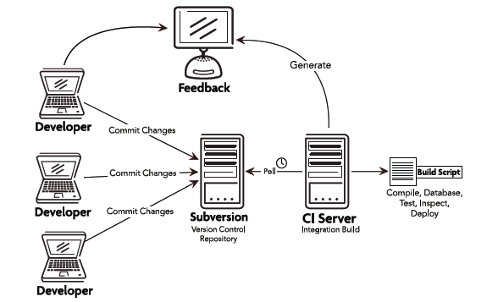
Continuous Integration

Slide 115
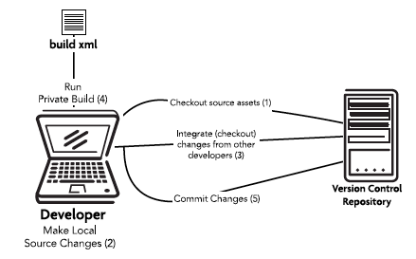
Workflow/Check-in steps

Slide 116
What is a successful build?
All the latest sources are checked out of the configuration management system
Every file is compiled from scratch
The resulting compiled code is put into binaries
The system is started and suite of tests is run against the system
Notes:
If all of these steps execute without error or human intervention and every test passes, then we have a successful build

Slide 117
Continuous Integration
Smells
Too many red builds
Long-running builds

Slide 118
Other considerations
Merging is a nightmare – why?
To branch or not to branch?
Definition of done
Code metrics
Notes:
Code metrics: test coverage, code complexity

Slide 119
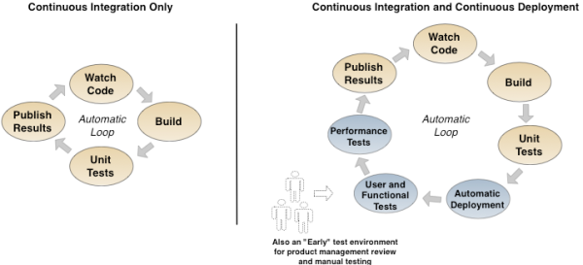
Continuous Integration and Deployment

Slide 120
Story #8
As a sales manager
I want to allow a free regular movie when the customer has 5 frequent renter points
So that I can encourage repeat customer

Slide 121
Continuous Delivery

Slide 122
Continuous Delivery Definition
Continuous Delivery is a software development discipline where you build software in such a way that the software can be released to production at any time.
Martin Fowler
Notes:
Furthermore CD in software development is a set of collaboration practices and engineering techniques, skills and tools that allow software products to be conceived, discovered and developed to a high standard and easily deployed, resulting in the ability to early, rapidly, reliably and repeatedly push out new features, enhancements and bug fixes at low risk and with minimal overhead.

Slide 123
Continuous Delivery value proposition
Main benefits
Increasing the throughput of new features and also the stability of the production systems: increasing innovation and predictability together at the same time
Close the gap between the Business and IT, between the Customers, the Market and the Business

Slide 124
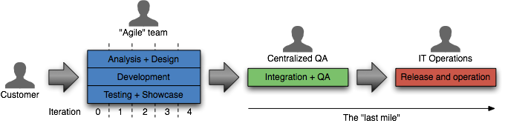
Continuous Delivery
Traditional approach to delivery
Notes:
How long would it take your organization to deploy a change that involves just one single line of code. – Mary and Tom Poppendieck
Do you do this on a repeatable, reliable basis?

Slide 125
Continuous Delivery
The ideal approach to delivery
Notes:
Through automation of the build, deployment, and testing process, and improved collaboration between developers, testers and operations, delivery teams can reduce cycle times and improve the quality of their software and the reliability of the release process.
Software always production-ready
Reliable deployments
Everyone can self-service deployments
Software is deployable if not deployed
Business drives releases: Releases tied to business needs, not operational constraints

Slide 126
Continuous Delivery
Principles
Create a repeatable process for releasing software
Automate almost everything
Keep everything in version control
If it hurts, do it more often, and bring the pain forward
Build quality in (Deming)
Done means released
Everybody is responsible for delivery
Continuous improvement

Slide 127
Deployment Pipeline
Notes:
deployment pipeline: a pattern for modeling the delivery process, ensuring everyone in delivery can self-service deployments, and providing fast feedback on the production readiness of their software upon every change to its source or configuration

Slide 128
Deployment Pipeline

Slide 129
Continuous Delivery
Stages and environments
Commit stage
Acceptance stage
Manual stages
Deployment stages

Slide 130
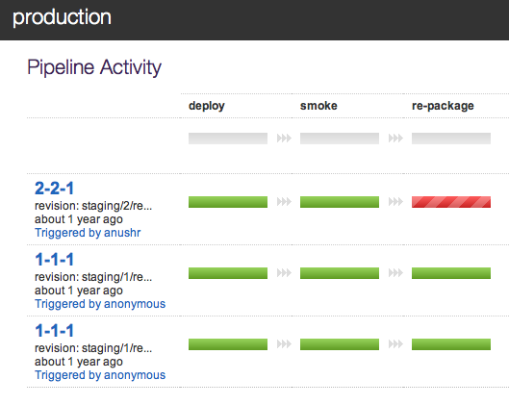
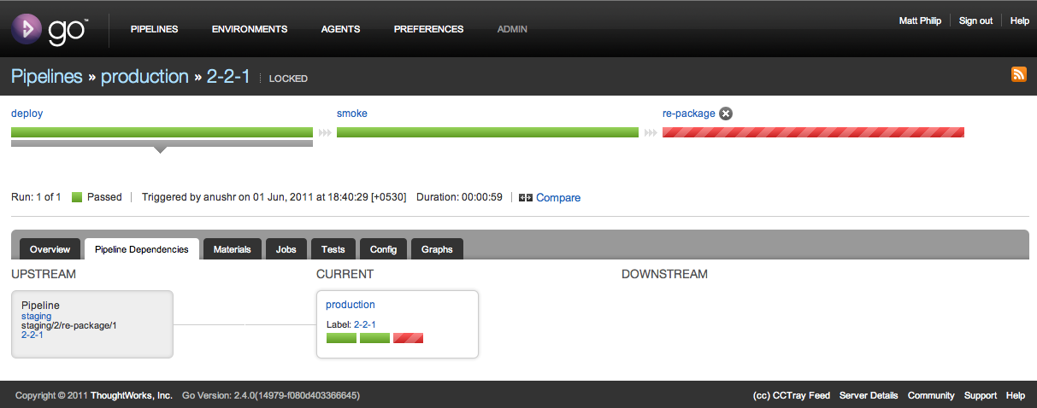
Continuous Delivery with Go

Slide 131
Continuous Delivery
Guidelines
Build your binaries only once
Deploy the same way to every environment
Smoke test your deployments
Keep your environments similar
If anything fails, stop the line

Slide 132
Continuous Delivery
Practices
Automated testing and deploy, C.I.
Trunk Based Development
Hot deploy with zero-downtime
Infrastructure automation
Monitoring and logging

Slide 133
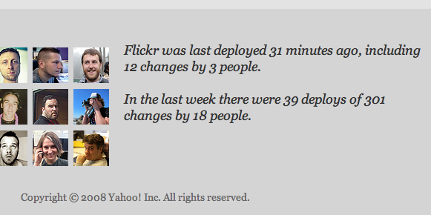
Continuous Delivery
Continuous Deployment
Deploying every good build to production
Automation must exist end-to-end
Reduces the risk of each individual deployment

Slide 134
Agile Development Practices
Thank you!

Slide 135
Agile Developer Practices
User Stories

Slide 136
Story 1
Role: As a marketing executive
Goal: I want to have different pricing for newly released movies
Value: So that I can increase my profit

Slide 137
Story Details
Pricing Model for newly released movies:
Up to 2 days $3 and after that everyday $2
e.g.
1 day rental - $3
2 day rental - $3
3 day rental - $5 ( $3 + $2)
4 day rental - $7 ($3 + (2*$2))

Slide 138
Story 2
Role: As a marketing executive
Goal: I want to have different pricing for classic movies
Value: So that customer can enjoy classic movies for long duration with low rentals

Slide 139
Story Details
Pricing Model for classic movies:
Everyday $0.5, for a week $3 and after than everyday $0.5
e.g.
1 day rental - $0.5
2 day rental - $1
7 day rental - $3
8 day rental - $3.5 ($3 + $0.5)
Note: enhance application to allow upto 10 days of rental

Slide 140
Mocking exercise
Login and Logout controller unit tests

Slide 141
Story 3
Role: As a marketing executive
Goal: I want to have frequent renter points program
Value: So that so that customer can win free movies and we get recurring customers

Slide 142
Frequent Renter Points
Newly Released Movies
2 points per day
All others
1 point per $ spent

Slide 143
Story 4
Role: As a customer
Goal: I want to view my accumulated frequent renter points
Value: So that so that I know when I get the free movie

Slide 144
Story 5
Role: As a customer
Goal: I want to view all my previous receipts as history
Value: So that so that I know my history of transactions

Slide 145
Story 6
Role: As a customer
Goal: I want to return my video (single video return using current rentals screen)
Value: So that I complete my transaction

Slide 146
Story 7
Role: As a store manager
Goal: I want to manage video inventory per movie basis
Value: So that I know when run out of stock

